Slide 1

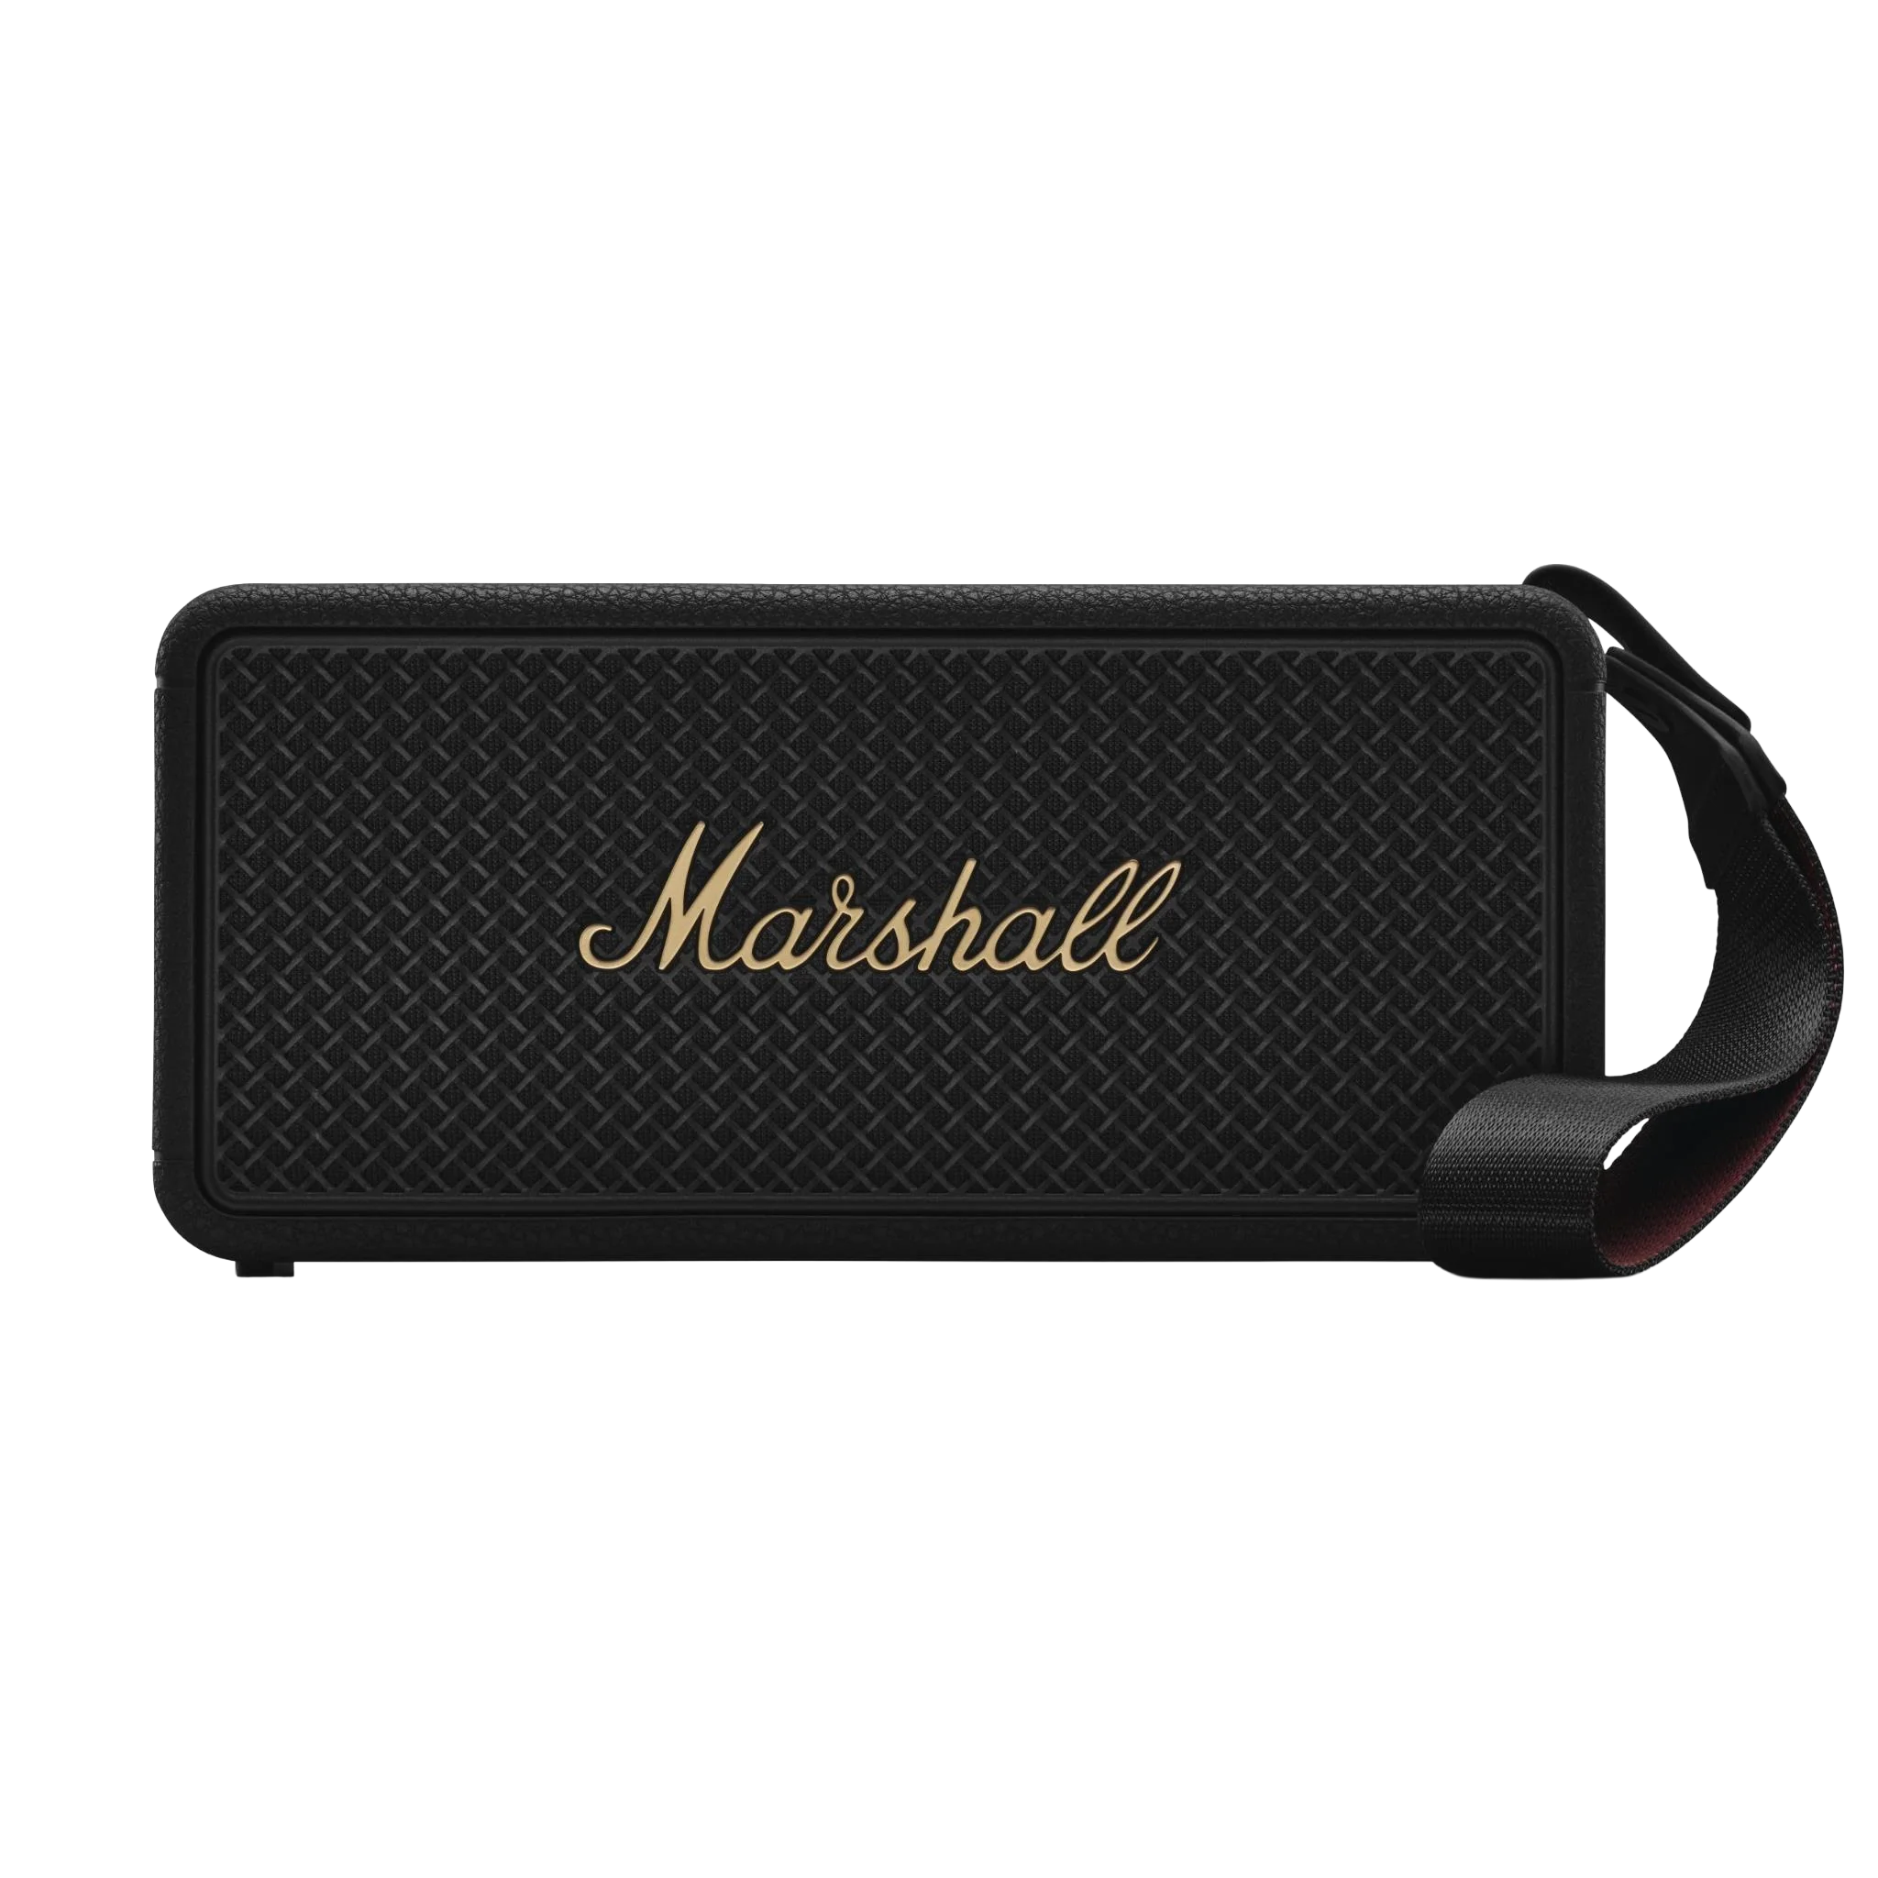
AI Builder Blitz
Compete at
AI Builder Blitz
Automation meets AI in a hands-on build challenge.
Take the top spot and win* a Marshall Middleton II Portable Speaker (AUD 499).

